Slide 1

Workshop.
MS Bot Framework
Face API
MS Bot Framework
Валерий Поляков, аналитик, Cognitive отдел, EVRY Ukraine
September 27, 2018

Slide 2
Intro
Your previous experience with:
Programming languages
VCS
Bot frameworks
Azure or other cloud
Your expectations
What do you want to know?
What makes you boring?

Slide 3
Prerequisites
Git
Setup git: https://git-scm.com/downloads
Register/Sigin GitHub: https://github.com
Node.js 8.12
https://nodejs.org
Bot Framework Emulator
https://github.com/Microsoft/BotFramework-Emulator/releases
Visual Studio Code
https://code.visualstudio.com/download
Mongodb
https://www.mongodb.com/
Azure
https://portal.azure.com

Slide 4
Agenda
Bot architecture
Console Bot
Echo Bot
Deploy to Azure

Slide 5
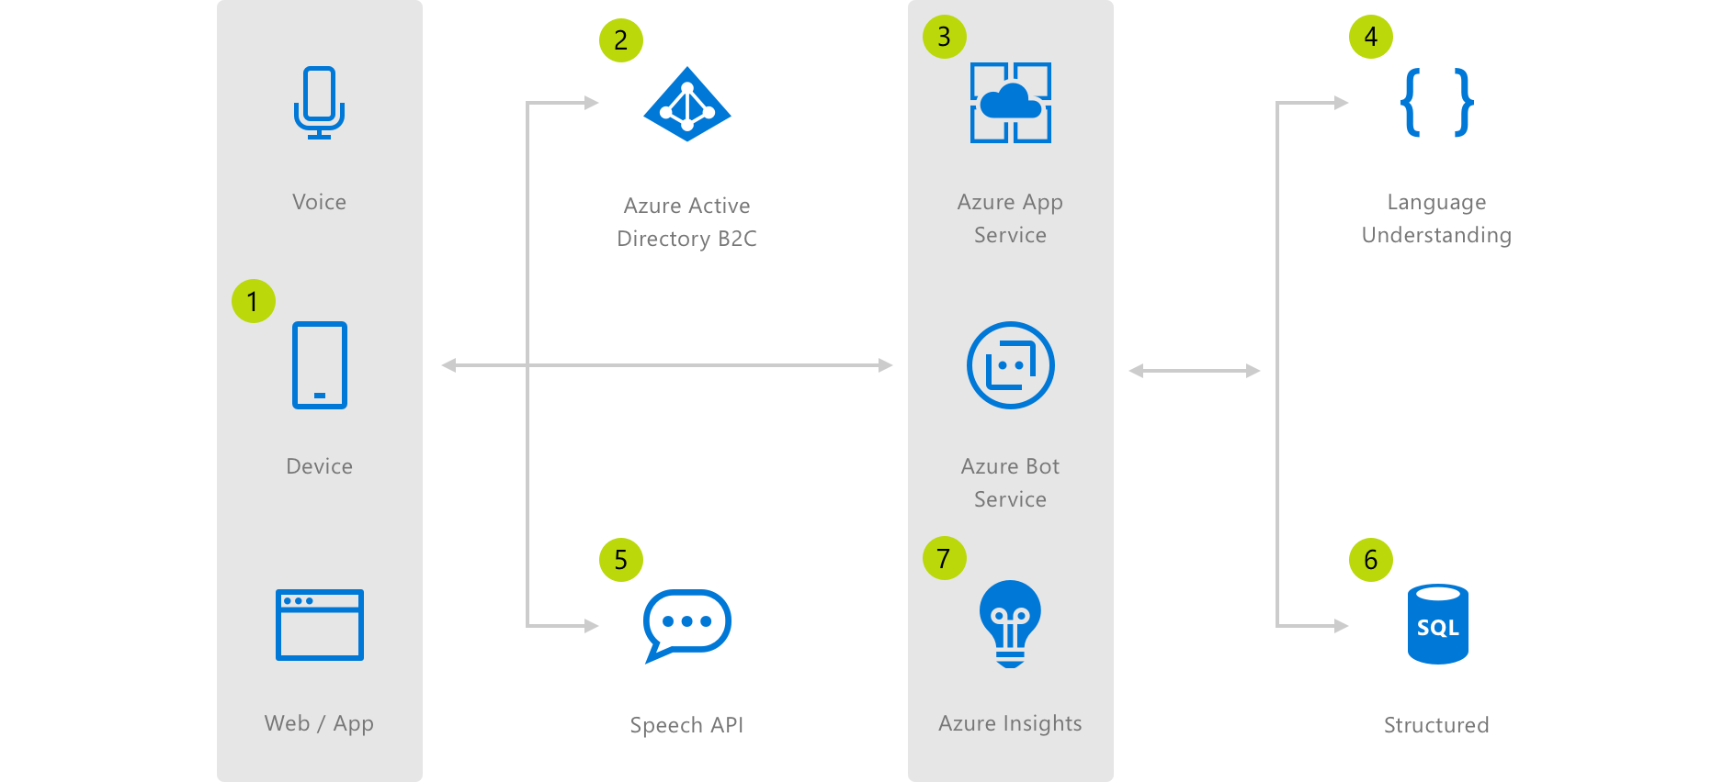
Bot architecture

Slide 6
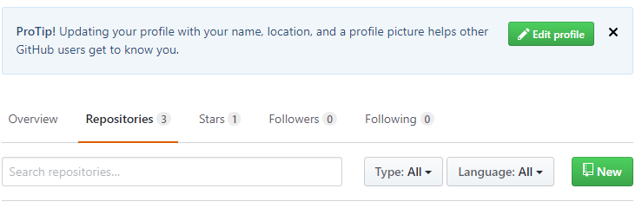
Bot: init
Create git repo Botlab
Click “Repositories” then “New”
Create folder
C:\Users\valerii.poliakov\Documents\workshop
Run “cmd” and navigate to created folder
Clone from git:
git clone https://github.com/Valerii-Poliakov/BotLab.git
Navigate to BotLab folder
Create .gitignore file and add to the GitHub
git add .gitignore
git commit -m "gitignore added"
git push
Run following npm command
npm init

Slide 7
.gitignore
# Dependency directories
node_modules/
jspm_packages/
# Optional npm cache directory
.npm
# dotenv environment variables file
.env
# Other
.DS_Store
.vscode/

Slide 8
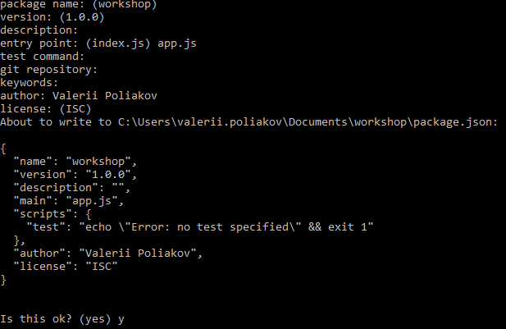
npm init

Slide 9
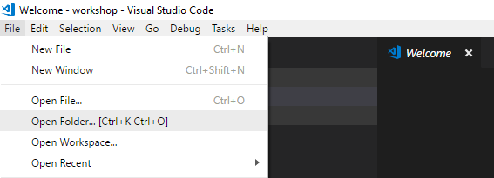
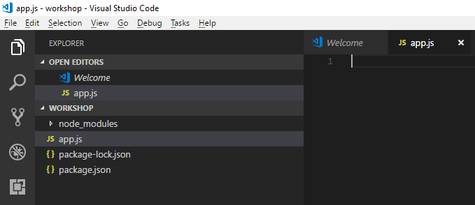
Bot: init
Install bot builder SDK
npm i --save botbuilder@3.15.0
Run Visual Studio Code
Open folder “BotLab”
Create a new file named app.js.

Slide 10
Console Bot: App.js
var builder = require('botbuilder');
var connector = new builder.ConsoleConnector().listen();
var bot = new builder.UniversalBot(connector, function (session) {
session.send("You said: %s", session.message.text);
});

Slide 11
Console Bot: run
Run bot
node app.js
Test bot
Type any message and press enter

Slide 12
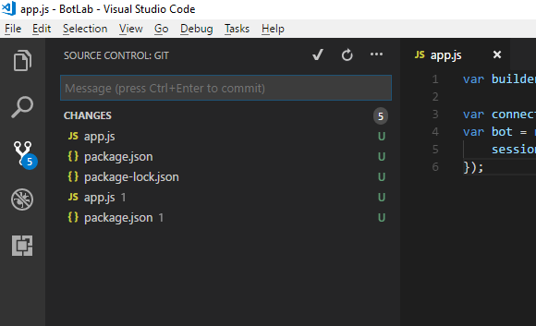
Push changes
From command line:
git add *
git commit -m “commit message“
git push
From UI

Slide 13
Echo bot
Install Restify
npm i --save restify
Modify app.js:
Require ‘restify’ module
Change ‘ConsoleConnector’ to ChatConnector
Add Microsoft App ID and App Passwrd.
Have the connector listen on an API endpoint.

Slide 14
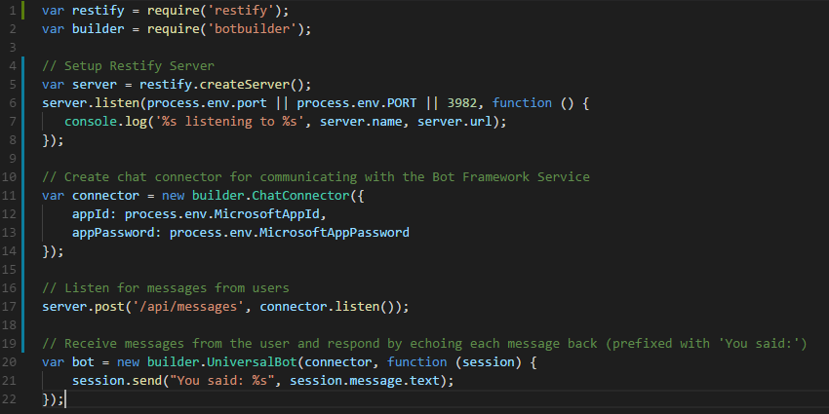
Echo Bot: app.js

Slide 15
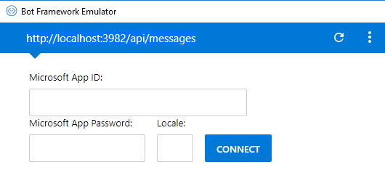
Echo Bot: run
Run bot
node app.js
Run botframework-emulator
Connect to the bot
http://localhost:port-number/api/messages
Chat with the bot

Slide 16
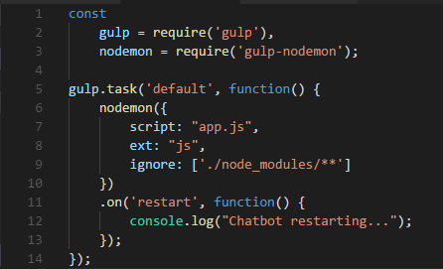
In Memory Storage
Add storage for sessions.
const inMemoryStorage = new builder.MemoryBotStorage();
…
var bot = new builder.UniversalBot(connector, function (session) {
session.send("You said: %s", session.message.text);
}).set('storage', inMemoryStorage);
Gulp
npm i –save gulp
npm i --save gulp-nodemon
add gulpfile.js

Slide 17
i18n
i18n
npm i --save i18n
App.js
var i18n = require('i18n');
i18n.configure({
defaultLocale: process.env.DEFAULT_LOCALE ? process.env.DEFAULT_LOCALE : 'en',
directory: __dirname + '/locales'
});
locales/en.json
en.json
{
"greeting": "Hi! I'm your chatbot."
}

Slide 18
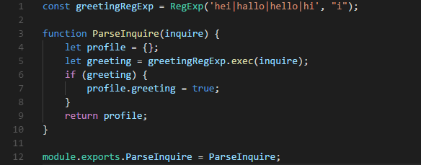
Greeting
Add parse-inquire.js
Modify app.js
var parser = require('./parse-inquire');
…
var bot = new builder.UniversalBot(connector, function (session) {
session.userData.profile = parser.ParseInquire(session.message.text);
if (session.userData.profile.greeting) {
session.send(i18n.__("greeting"));
}
else {
session.send("You said: %s", session.message.text);
}
}).set('storage', inMemoryStorage);

Slide 19
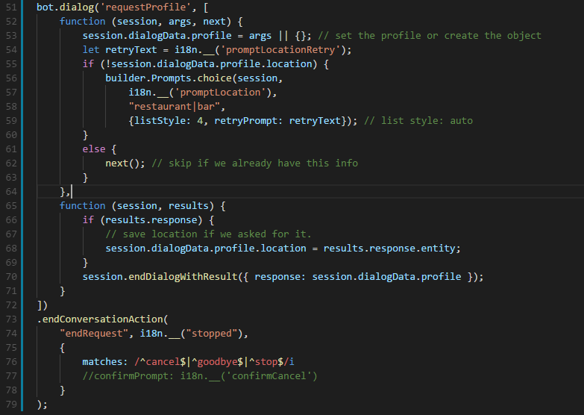
Prompt user input

Slide 20
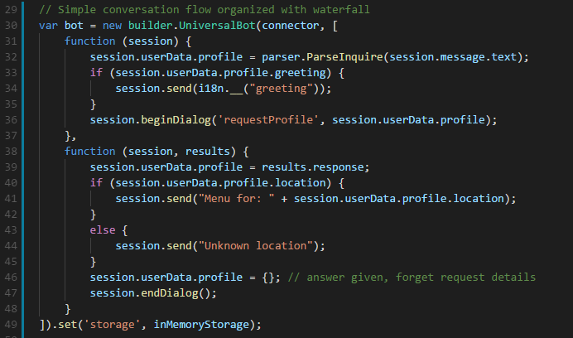
Conversation flow
Manage conversation flow:
https://docs.microsoft.com/en-us/azure/bot-service/nodejs/bot-builder-nodejs-dialog-manage-conversation-flow?view=azure-bot-service-3.0

Slide 21
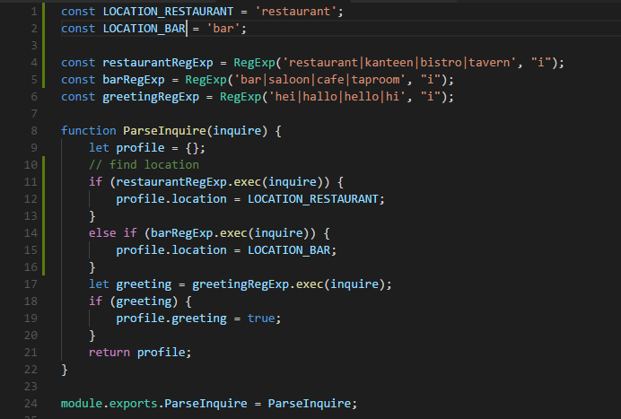
Improved perception
Modify parse-inquire.js

Slide 22

Deploy
Notes:
Итак, вот пять главных уроков, которые мы вынесли из этого кейса.

Slide 23
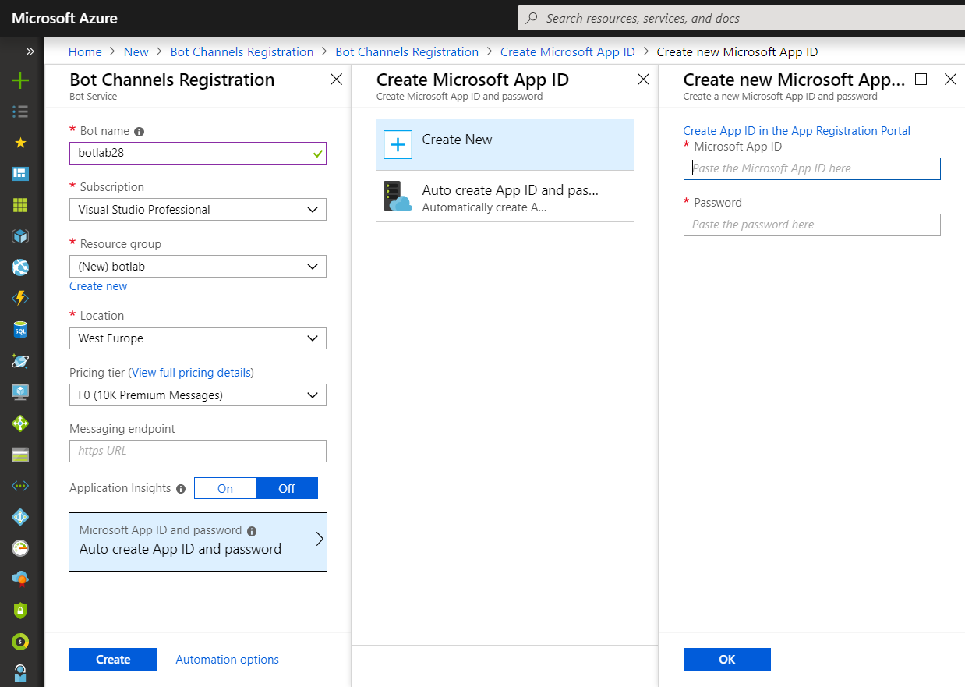
Publish Bot: Step 1
Create .env file in your project
Go to portal.azure.com
Add Bot Channel Registration
Enter bot name
Create resource group
Choose location
Pricing: F0
Application Insights: off
Create App ID in the App Registration Portal
Copy App ID/Password to .env
Copy to App Id and Password fields and click OK
Click Create
Wait for deployment completion

Slide 24
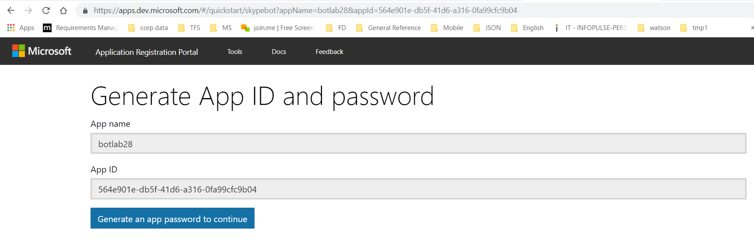
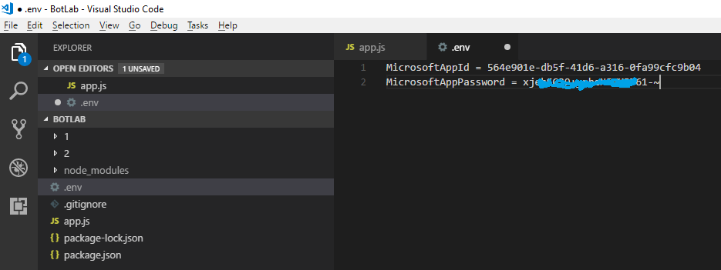
Application Registration

Slide 25
Publish Bot: Step 2
Create application service (Web App)
App name – same as bot channel registration name (not necessary but convenient)
Use existing resource group – same as bot channel registration
OS: Linux
Runtime Stack: Node.js 8.11
Click ‘Create’ and wait for deployment…
Configure web app settings
Deployment option -> GitHub
Choose project
Choose branch (master by default)
Click OK
Set App ID and Password
Click ‘Application Settings’
Startup File: app.js
Add new setting: MicrosoftAppId, MicrosoftAppPassword
Save and Restart

Slide 26
Publish Bot: Step 3
Test endpoint: https://botlab28.azurewebsites.net/api/messages
Go to our bot channel registration
Click ‘Settings’
Set messaging endpoint:
https://botlab28.azurewebsites.net/api/messages
Save
Test in Web Chat

Slide 27

Bonus
Notes:
Итак, вот пять главных уроков, которые мы вынесли из этого кейса.

Slide 28
Setup mongodb
Install mongodb instance
Install “mongoose”
npm i --save mongoose
Modify app.js
const mongoose = require('mongoose');
…
// mongodb connection
mongoose.connect(process.env.MONGO_URL || 'mongodb://localhost/menu');
let db = mongoose.connection;
db.on('error', console.error.bind(console, 'connection error:'));
db.once('open', function() {
console.log("Menu DB connected.");
});

Slide 29
Model and Schema
Create models\menu-model.js
menu-model.js
const mongoose = require('mongoose'),
Schema = mongoose.Schema;
let menuModel = new Schema({
Place: { type: String },
OpeningHours: { type: String },
Dish: { type: String },
Price: { type: String }
});
module.exports = mongoose.model('Menu', menuModel);

Slide 30
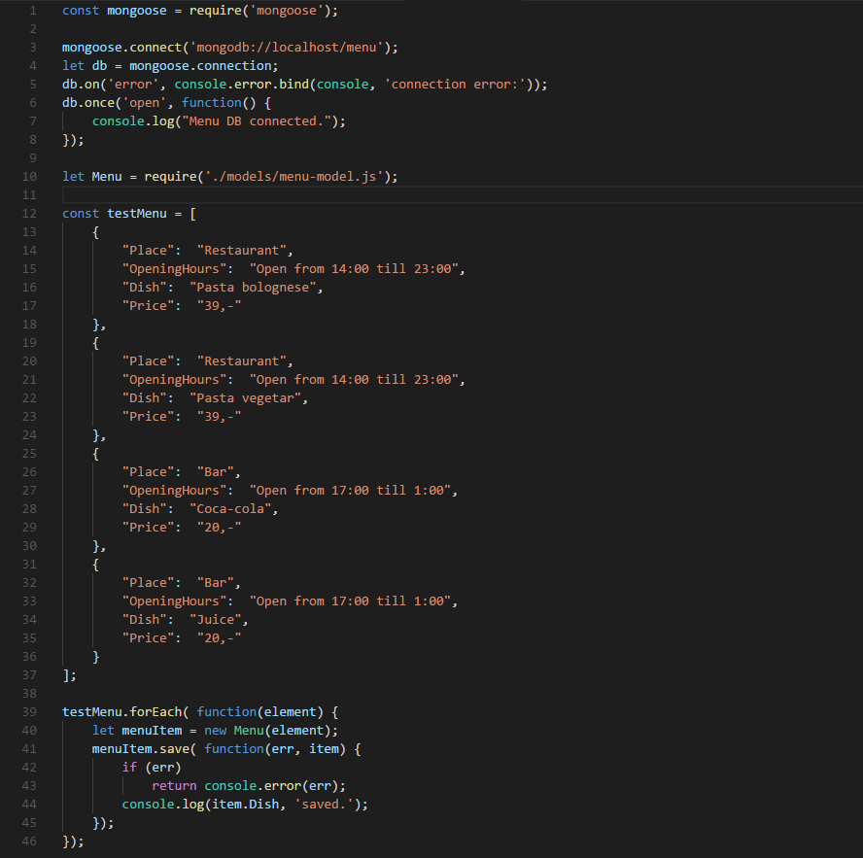
Init DB
Init-db.js

Slide 31
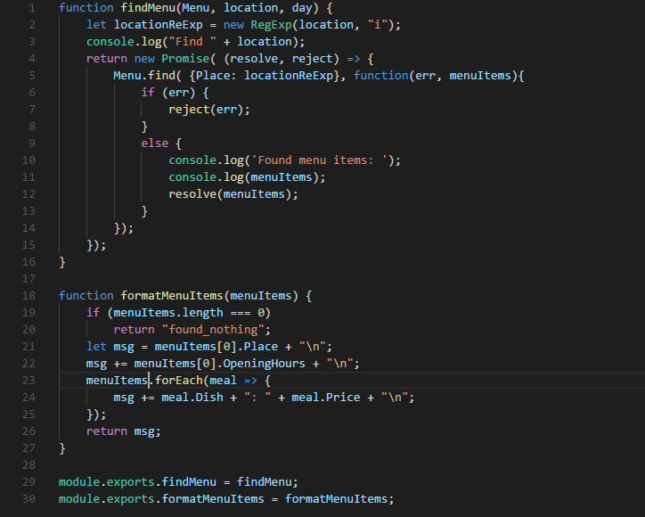
Query DB and format output
menu-queries.js

Slide 32
Query menu information
Modify app.js
const Menu = require('./models/menu-model.js');
const queries = require('./queries/menu-queries');
…
if (session.userData.profile.location) {
//session.send("Menu for: " + session.userData.profile.location);
queries.findMenu(Menu, session.userData.profile.location)
.then( (result) => {
session.send(queries.formatMenuItems(result));
})
.catch( (err) => {
session.send(err)
});
}

Slide 33
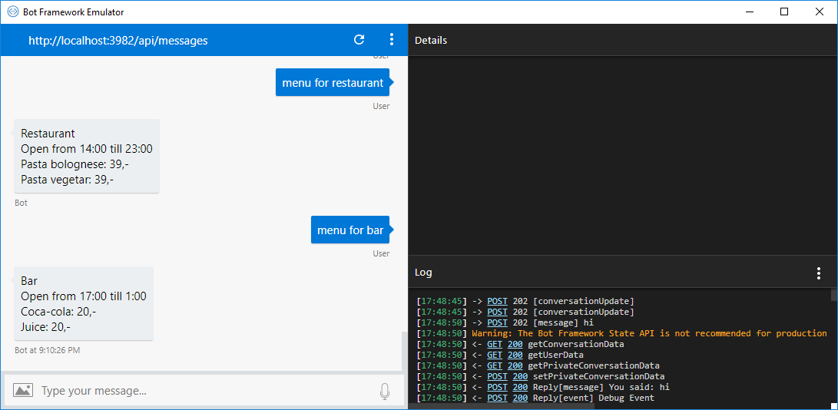
Demo

Slide 34


Дякуємо за увагу!
Notes:
Вместо постскриптума
Можем смело вас заверить – решить можно любую задачу даже в самых сложных случаях. Каким бы большим и сложным ни был ваш бизнес, нужно не бояться проводить изменения. Помните – технологии – это в первую очередь инструмент, и в правильных руках – это залог вашего успеха.

Slide 35







Наші контакти:
+38 044 585-25-00
www.infopulse.com
Вул. Польова, 24, Київ, Україна, 03056
info@infopulse.com
/InfopulseGlobal
/InfopulseGlobal
/company/infopulse

